Slide 1

RTÉ Player
Tim Tector, Ciaran Duggan, Gavin Walsh

Slide 2
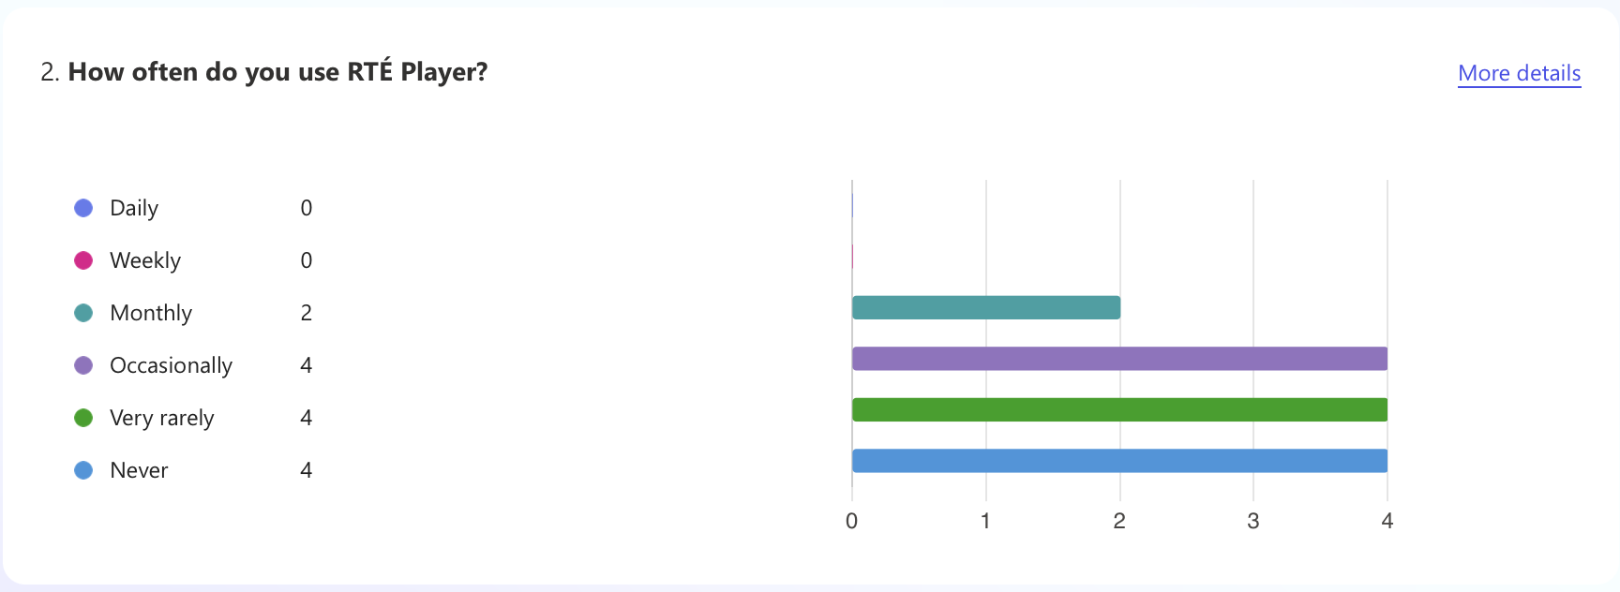
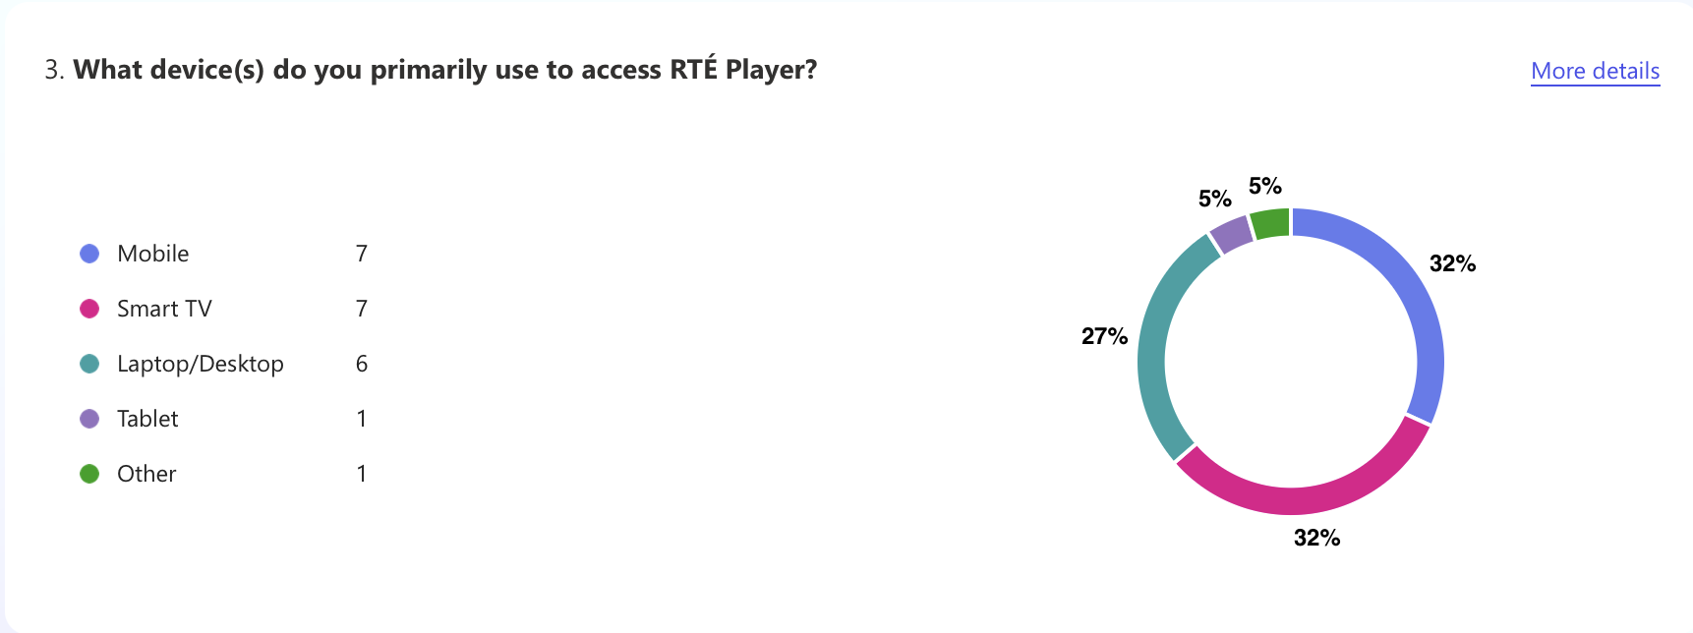
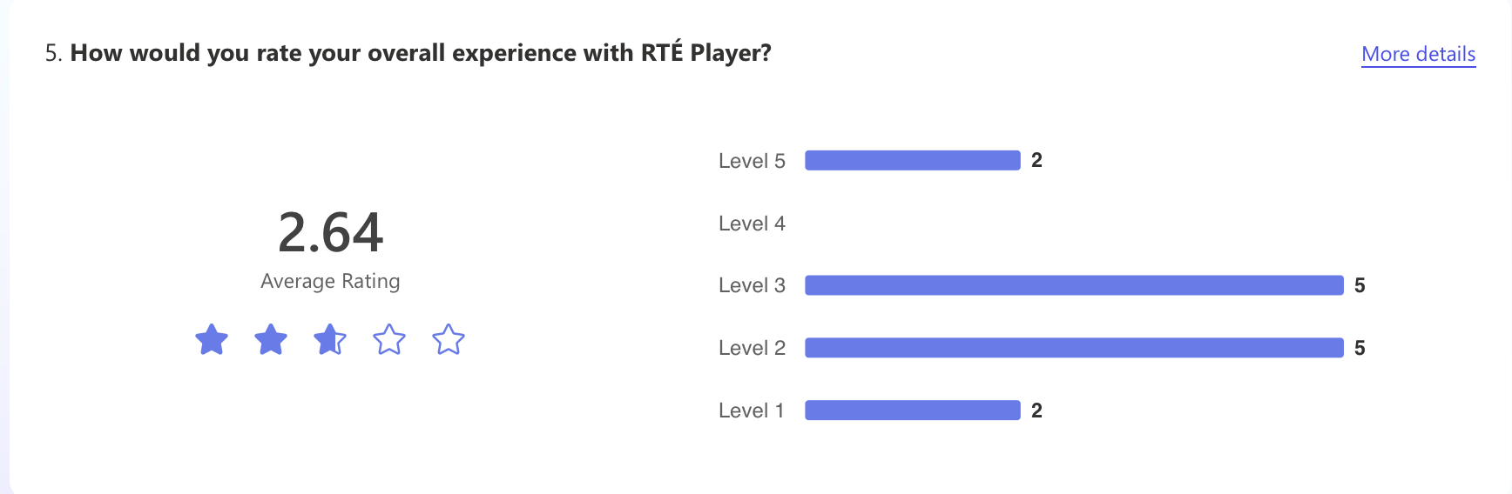
User Research: Usage Patterns & Satisfaction
Usage: No daily/weekly users; 29% use occasionally, 29% very rarely, 29% never.
Devices: Mostly mobile (50%) and Smart TV (50%).
Satisfaction: Average rating 2.64/5; 64% find too many ads.

Slide 3
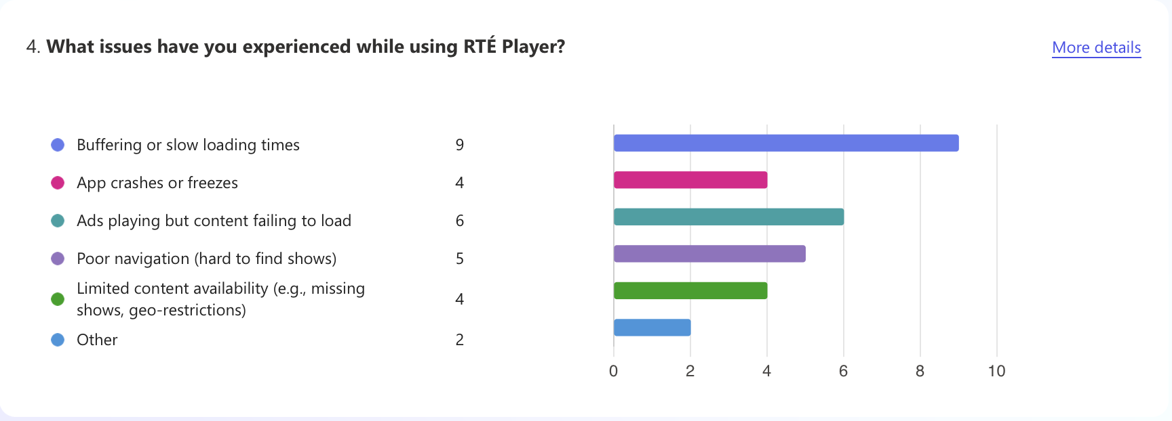
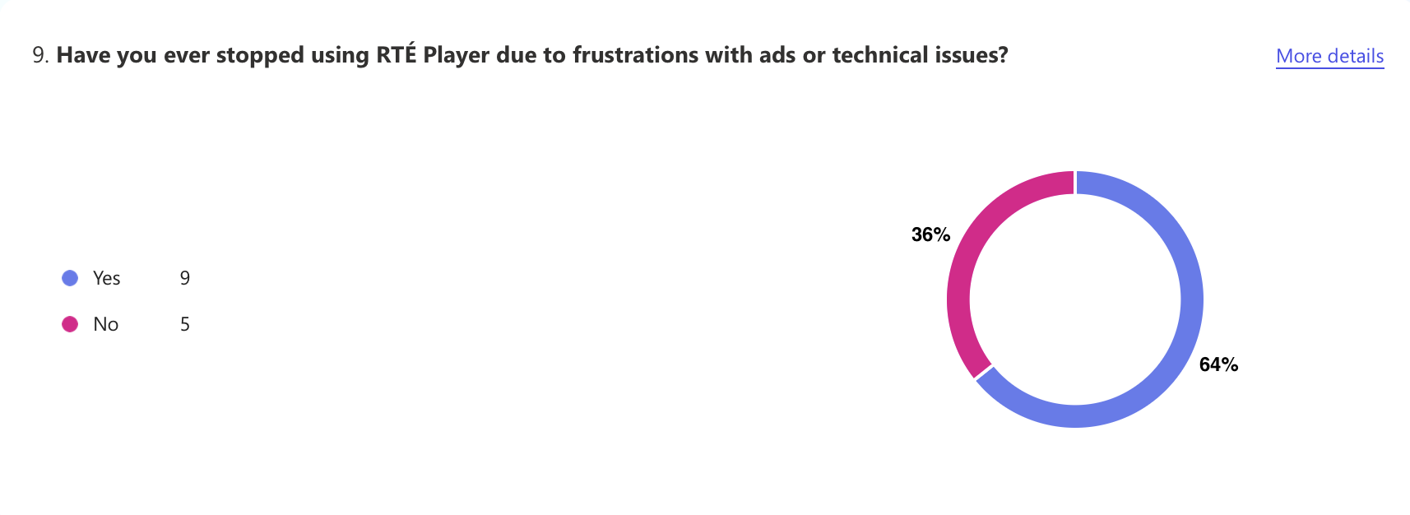
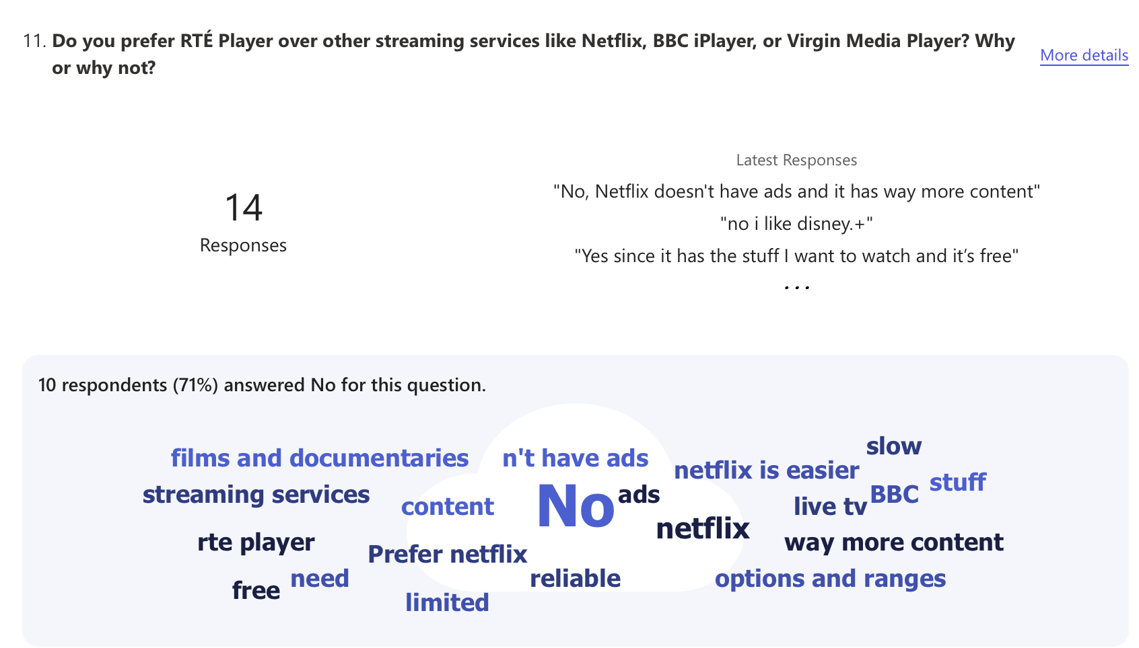
User Research: Usage Patterns & Satisfaction
Top Issues: Buffering (64%), ads failing to load content (43%), poor navigation (36%).
64% stopped using RTÉ Player due to ads/technical issues.
Preferences: 71% prefer other services (e.g., Netflix) due to no ads, more content.

Slide 4
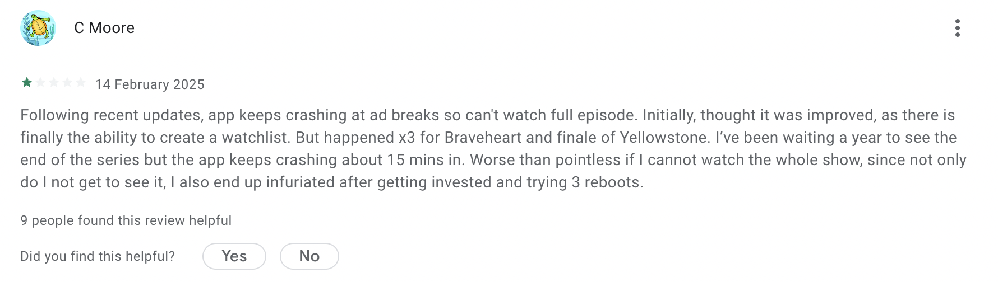
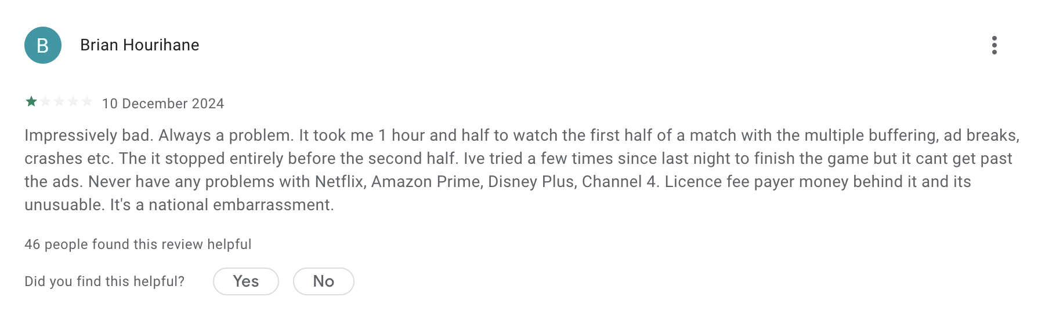
Desk Research

Slide 5
Persona 1: Frustrated Fiona
Name and Age: Fiona O'Connor - 32
Occupation: Marketing Manager
Location: Dublin, Ireland
Device: Uses RTÉ Player mainly on a Smart TV and mobile phone
Tech-Savviness: Medium (Comfortable with technology but not a heavy user)
Needs:
Improved streaming quality with fewer interruptions.
Access to international content or the ability to share content with family and friends abroad.
A smoother user interface for finding shows more quickly and easily.
Behavior:
Uses RTÉ Player primarily for catching up on TV shows and news in the evenings.
Frustrated by the inconsistency of streaming, especially during high-demand times like sports events.
Considers alternatives like Netflix for smoother experiences but prefers local content on RTÉ Player.
Goals:
Watch her favorite Irish TV shows (e.g., "The Late Late Show") and catch up on news content.
Stream live events (e.g., major sports events like rugby or elections) when on the go.
Challenges:
Buffering/slow streaming: Fiona often faces buffering or slow loading times while watching content, particularly for live events or high-traffic periods. She finds it frustrating when important live broadcasts are interrupted.
Content Availability: Fiona is frustrated that certain shows are not available outside of Ireland. She has family living abroad and would love to share the content with them but is often blocked by geo-restrictions.
Ads: Fiona feels there are too many ads in between her shows, and while the ads work fine, the actual content often has trouble loading afterward.

Slide 6
Persona 2: Irritated Ian
Name and Age: Ian Murphy - 45
Occupation: Software Developer
Location: London, UK (Originally from Cork, Ireland)
Device: Laptop and tablet
Tech-Savviness: High (Comfortable with tech and always looks for ways to optimize his user experience)
Goals:
Watch Irish content (e.g., "Fair City", "Prime Time") to stay connected with Irish culture.
Stream live sports events (e.g., Irish rugby games) and news programming.
Avoid geo-restrictions that block him from watching certain content while living abroad.
Challenges:
Geo-restrictions: Ian often struggles to access specific shows or content due to geo-blocking. He cannot access content that is only available within Ireland, which is frustrating for someone living abroad.
Technical Glitches: Ian experiences buffering or video freezes, especially when trying to stream high-definition content.
Navigation Issues: The platform’s design feels cluttered, and Ian struggles to find specific programs quickly, wasting time scrolling or searching.
Needs:
Better international access to shows that are restricted by location.
Stable streaming performance with a focus on improving buffering and video quality.
A more intuitive and streamlined user interface for faster content discovery.
Behavior:
Uses RTÉ Player to stay connected to Ireland and watch his favorite shows and live events, but is often disappointed by the streaming quality and the lack of access to content abroad.
Frequently complains on forums or social media about the limited availability of content internationally and the technical glitches that occur during peak times.
Would be willing to pay for a premium RTÉ Player service if it addressed the geo-blocking and quality issues.

Slide 7


Empathy Map: Frustrated Fiona.
Thinks :
"Why does streaming quality drop during live events?"
"I just want to watch without buffering interruptions."
"Why are some shows blocked outside Ireland?"
"Maybe I should switch to another platform, but I love local content."
Feels :
Frustrated by buffering, especially during live events.
Annoyed that ads load perfectly, but content struggles.
Disappointed she can’t share shows with family abroad.
Overwhelmed by a clunky user interface.

Slide 8


Empathy Map: Frustrated Fiona.
Says :
"Why do ads load instantly, but my show keeps buffering?"
"I just want to catch up on the news without interruptions!"
"Why is this show not available outside Ireland?"
"RTÉ Player needs a better layout to find content faster."
Does :
Watches TV shows and news mainly on RTÉ Player.
Attempts to stream live sports but gets frustrated with buffering.
Looks into Netflix but sticks with RTÉ for Irish content.
Tries (and fails) to share shows with family abroad.

Slide 9

Key Issues Identified
Slow Streaming and Buffering:
Both Fiona and Ian experience slow loading times and buffering, especially during live events and high-traffic times. This interrupts their ability to enjoy the service.
Problem: RTÉ Player’s performance is inconsistent, and users experience frustration when trying to access content smoothly.
Geo-Restrictions on Content:
Ian, as an international user, finds that much of RTÉ Player's content is geo-blocked, preventing him from watching Irish shows and sports events while living abroad. Fiona, while based in Ireland, also feels disconnected when trying to share content with family overseas.
Problem: Geo-blocking restricts access to content for international users, which limits the global appeal and accessibility of RTÉ Player.
Overwhelming and Interruptive Ads:
Fiona is frustrated by the number of ads interrupting her viewing experience, especially when the content is already loading slowly. The ads are poorly timed and detract from her overall enjoyment.
Problem: Ads are disruptive and interfere with the user experience, especially when combined with technical issues like slow loading.
Cluttered and Intuitive User Interface:
Both personas struggle with navigating RTÉ Player. Fiona finds it difficult to locate her desired content, and Ian has trouble accessing specific programs quickly.
Problem: The user interface is not user-friendly, making it difficult to quickly find and stream content. This leads to frustration and wasted time.

Slide 10
As Is and To Be Scenarios Bases On These Key Issues

Slide 11
Task 1: Watching a Favorite TV Show
Scenario: Fiona wants to watch her favorite Irish TV show, "The Late Late Show", after a busy workday.
As Is:
Fiona opens the RTÉ Player app on her Smart TV after a long day at work.
She scrolls through the homepage, trying to locate "The Late Late Show," but the layout is cluttered with too many recommendations and ads that distract her.
Once she finds the show, she clicks on it and is met with buffering for several minutes.
After finally starting the show, ads interrupt her viewing every few minutes. The app is lagging, and sometimes it freezes.
Fiona is frustrated by delays during key moments in the show, especially when the app fails to load smoothly during high-traffic times.
If she tries to skip ahead to catch up, it buffers again, and she misses parts of the show. She spends more time waiting than watching.
To Be:
Fiona opens the RTÉ Player app on her Smart TV.
Upon launch, the home screen is organized with a simple, clear layout that highlights "The Late Late Show" under "My Favorite Shows" or "Trending" for easy access.
She clicks on the show, and it loads instantly without buffering, thanks to improved streaming technology that adapts to her network speed.
No ads interrupt her viewing, or if ads are present, they are placed at the beginning and end of the show, not in between key moments. She has the option to upgrade to an ad-free experience or to enjoy fewer interruptions with a more optimized ad experience.
If Fiona wants to skip ahead, the show resumes immediately from her desired point without freezing or buffering.
The content is smooth throughout, providing an uninterrupted and enjoyable viewing experience.

Slide 12
Task 2: Accessing Content from Abroad
Scenario: Fiona is traveling abroad and wants to watch Irish content on RTÉ Player to stay connected with her culture.
As Is:
Fiona opens RTÉ Player while abroad, excited to watch the latest Irish TV show.
She is blocked by a geo-restriction message: "This content is only available within Ireland."
She tries accessing the app through different networks (e.g., mobile data, Wi-Fi) but still encounters the same issue.
Fiona is frustrated because she cannot access the content she wants, feeling disconnected from Ireland.
Fiona tries to find alternative methods, like using a VPN, but it’s difficult to find a reliable solution and often results in poor performance or more technical issues.

Slide 13
To Be:
Fiona opens RTÉ Player while traveling abroad and is presented with an option to subscribe to a premium service that allows access to all content outside of Ireland.
After subscribing, Fiona can access her favorite shows and live sports events without geo-restrictions, watching the content she loves from anywhere.
The RTÉ Player offers a reliable, region-free version for international users, eliminating the need for workarounds like VPNs.
Fiona feels connected to Ireland no matter where she is and enjoys the same quality and speed as domestic users without interruptions.
She can also share the content with her family overseas by sharing links or having them access content with a similar premium subscription.

Slide 14
How Have Other Apps Handled These Problems?

Slide 15
1. Streaming Performance and Buffering
Challenge with RTÉ Player:
Fiona faces frequent buffering and slow loading times, especially during peak periods or when accessing live events.
Successful Example: Netflix
How Netflix Solves It:
Netflix uses adaptive streaming technology that adjusts the video quality based on the user’s internet speed. This ensures smooth playback even in low-bandwidth situations, significantly reducing buffering.
Buffering Prevention: Netflix preloads a portion of the content so users experience minimal disruption.
Performance During Live Events: For live broadcasts, Netflix has a dedicated infrastructure that can handle high demand and ensure content is served efficiently.
What RTÉ Player Can Learn:
RTÉ Player can adopt adaptive streaming technology to ensure that users have an uninterrupted experience, regardless of internet speed or peak usage times.
RTÉ Player should consider preloading content to minimize buffering, especially for high-demand live events like sports broadcasts or popular TV shows.

Slide 16

2. Geo-Restrictions
Challenge with RTÉ Player:
Fiona is blocked from accessing content when abroad due to geo-restrictions, and this limits her ability to stay connected with Irish programming.
Successful Example: BBC iPlayer
How BBC iPlayer Solves It:
BBC iPlayer is limited to the UK, but the BBC has launched BBC iPlayer for international audiences as part of its global subscription service, where users in other countries can access content for a subscription fee.
The service offers international users a wider range of British TV shows and sports events without the frustrating geo-blocks, ensuring continuity and global accessibility.
What RTÉ Player Can Learn:
RTÉ Player could offer a premium international subscription that grants users access to all content worldwide. This would not only provide a better experience for users like Fiona but also expand their global audience base.
RTÉ Player could explore partnerships to license their content for global viewing, removing geo-restrictions for overseas users.

Slide 17
3. Ad Experience
Challenge with RTÉ Player:
Fiona finds ads on RTÉ Player interruptive, especially when they appear in the middle of the show, which disrupts the overall viewing experience.
Successful Example: YouTube
How YouTube Solves It:
Ad-Free Option: YouTube offers YouTube Premium, a subscription service that removes all ads from videos and gives users a better viewing experience.
Ad Placement: YouTube uses a combination of pre-roll ads, mid-roll ads, and post-roll ads, with user control over when ads are played in some cases. The service also limits the number of ads shown during content.
For free users, YouTube intelligently places ads at natural breaks (e.g., before a video starts, in between different videos, or at natural pauses) rather than disrupting the content itself.
What RTÉ Player Can Learn:
RTÉ Player could introduce a premium subscription model (similar to YouTube Premium) to give users the option to watch ad-free.
RTÉ could rework ad placement to avoid interrupting shows in the middle of viewing and ensure ads are placed during more natural breaks, making them less intrusive.

Slide 18
4. User Interface (UI) Design and Navigation
Challenge with RTÉ Player:
Fiona struggles with navigating RTÉ Player’s cluttered interface, where content is hard to find, and the layout is overwhelming.
Successful Example: Disney+
How Disney+ Solves It:
Disney+ offers a clean and simple interface, prioritizing easy navigation. Users can immediately find featured content, and the app uses larger thumbnails and clear categories (e.g., Trending, New Releases, My List) to make browsing intuitive.
The search function is intuitive and fast, with filters and recommendations tailored to the user’s previous interactions, making it easier to find content.
The interface is responsive and clutter-free, focusing on the essentials with easy-to-read fonts, large icons, and minimal distractions.
What RTÉ Player Can Learn:
RTÉ Player should consider a streamlined, minimalist UI that reduces clutter and helps users find content quickly.
The app could use intuitive search functions with filtering options like "Popular," "Recently Added," and "My List" to make it easier for users to access content.
Larger content thumbnails and easy navigation (e.g., a top bar with categories like "Live TV," "Catch Up," "Sport," and "News") would help users navigate without feeling overwhelmed.

Slide 19

Thanks For Listening
By Tim Tector, Ciaran Duggan and Gavin Walsh.

